Slide 1
Welcome to the AHT Informational Meeting. Please make sure your microphones are muted unless you have a question. Please hold all questions until the end of the meeting.
Important upcoming dates:
Next Meeting – January 8th
MANDATORY in-person meeting at the AYCC – March 25th
General questions: Abbie Charrier acharrier@clubaycc.org
Account & Financial aid questions: Wendy Grenier wgrenier@clubaycc.org

Slide 2
Abbie Charrier
Youth Programs Director, AYCC
acharrier@clubaycc.org
(207)873-0684
americanheritagetour.org
This meeting is being recorded
If this is your first meeting and you want to receive email updates, please put your First name, Last name, and email in the chat
Please keep microphones muted and hold all questions until the end of the meeting.

Slide 3
Agenda:
Background Checks
Trip Apparel
Expectations
Day One Itinerary
Facebook Group for Participants
Please keep microphones muted and hold all questions until the end of the meeting.

Slide 4
Background Checks:
All chaperones must complete background checks and submit them to Abbie via email. The link to the background checks will be sent to you tomorrow.
Please keep microphones muted and hold all questions until the end of the meeting.

Slide 5
Trip Apparel:
Chaperones wear RED
Students wear BLUE
Everywhere! If you are outside of your hotel room or off the bus you are wearing your colors!
Everyone gets two tshirts and one jacket of the appropriate color. There will be additional apparel to purchase if you wish. You can wear clothes that are not ‘AHT’ if it is the right color.
Please keep microphones muted and hold all questions until the end of the meeting.

Slide 6
Bus Expectations:
Each chaperone group will be assigned to a bus. That assignment stays the same for the entire week.
The seat you pick in the morning is yours for the day
Chaperones must be spread out on the bus and are responsible for supervising their students on the bus
No one gets on the bus until the Bus Leader is there
Everyone is responsible for keeping their own area clean on the bus
When bus leaders or tour guides are talking everyone will give them their undivided attention
There is a bathroom on the bus for emergencies
Please keep microphones muted and hold all questions until the end of the meeting.

Slide 7
Chore Chart:
Many hands make light work! Each chaperone group will be assigned ‘chores’ for their bus throughout the week.
Loading luggage
Unloading luggage
Sweeping the bus
Please keep microphones muted and hold all questions until the end of the meeting.

Slide 8
Supervision Expectations:
To ensure everyone is safely accounted for on the trip we ask
At least one chaperone is with students whenever we are in public or in the hotel
Students are responsible for staying with their chaperone
Chaperones are responsible for keeping track of their students
Bus leaders are responsible for keeping track of everyone!
Please keep microphones muted and hold all questions until the end of the meeting.

Slide 9
Itinerary Details: Day One
Please keep microphones muted and hold all questions until the end of the meeting.

Slide 10
Next Steps: If you have registered
Talk with your chaperone group to start deciding what you want to do in your free time
Chaperones complete background checks
Join the 2024 AHT Participants Facebook Group
Continue to attend meetings
Next meeting is January 8th
Please keep microphones muted and hold all questions until the end of the meeting.

Slide 11
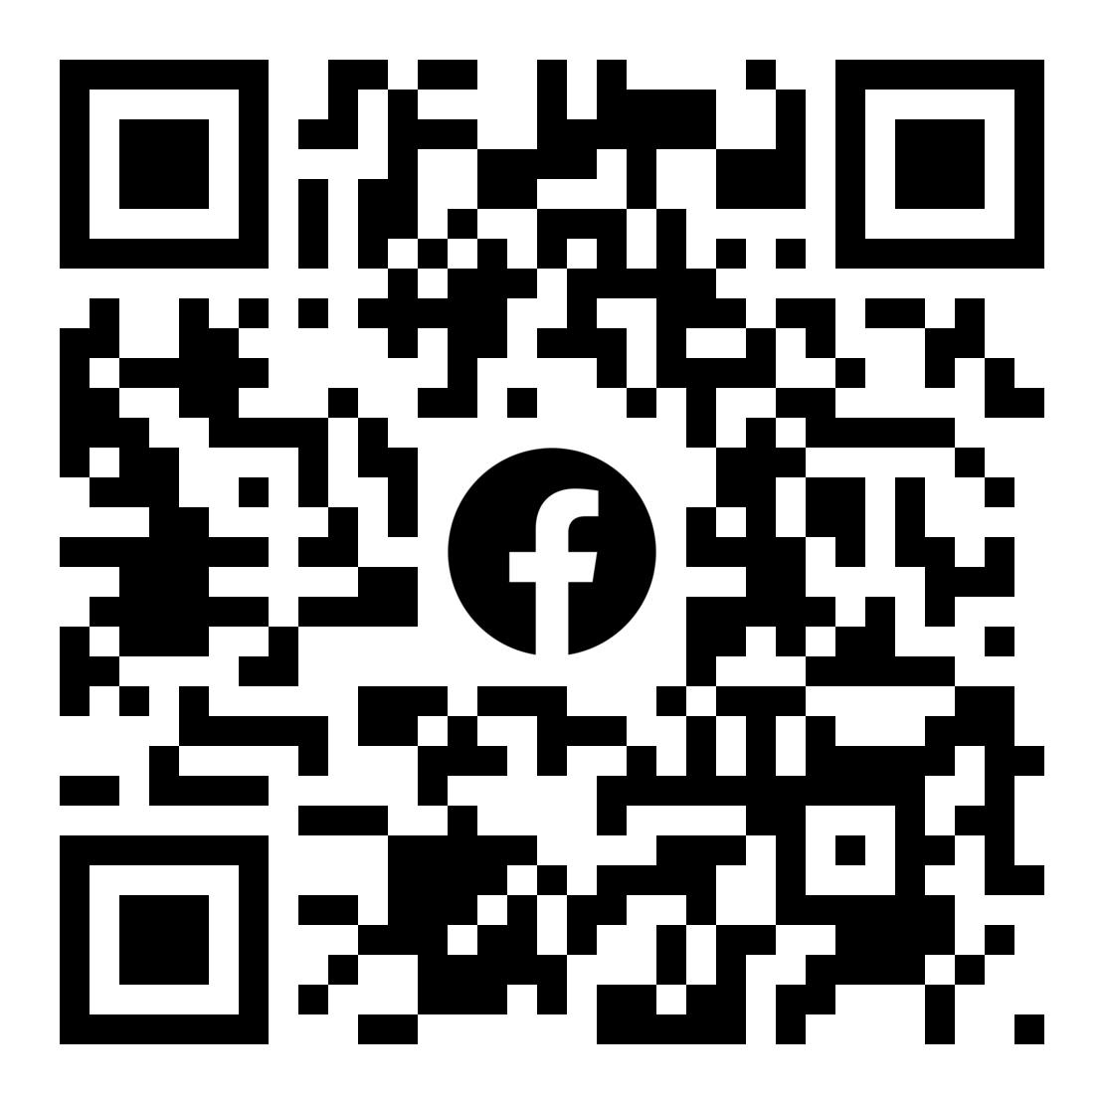

Slide 12
Questions
Abbie Charrier
acharrier@clubaycc.org
Financial aid, Registration, or Account questions: Wendy Grenier wgrenier@clubaycc.org
(207)873-0684
americanheritagetour.org
If you want to receive email updates, please put your First name, Last name, and email in the chat

